Slide 1
Day 40

Slide 2
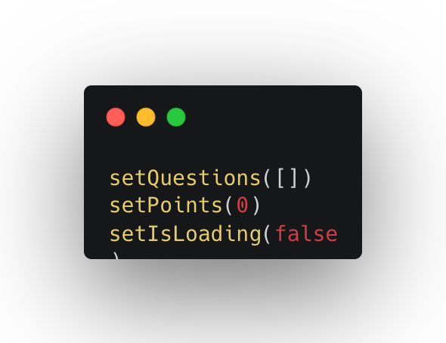
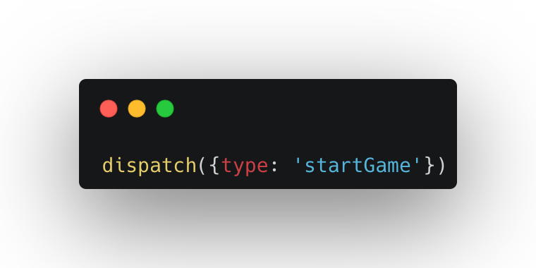
useState vs useReducer
useState
useReducer
Ideal for single, independent piece of state (numbers, strings, single arrays, etc.)
Logic to update state is placed directly in event handlers or effects, spread all over one or multiple components
State is updated by calling setState (setter returned from useState)
Imperative state updates
Easy to understand and to use
Ideal for multiple related pieces of state and complex state (e.g. object with many values and nested objects or arrays)
Logic to update state lives in once central place, decoupled from components: the reducer
State is updated by dispatching an action to a reducer
Declarative state updates: complex state transitions are mapped to actions
More difficult to understand and implement

Slide 3
When to use useReducer?
Just one piece of state?
Yes
No
Do states frequently update together?
Yes
No
Yes
Over 3 or 4 pieces of related state, including objects?
Are you willing to implement slightly more complex code
No
No
Yes
To many event handler’s make components large and confusiong?
useReducer
Yes
No
useState
Note: useState should remain your default choice for managing state

Slide 4
CSS styling Options
Styling Option | Where | How | Scope | Based on
Inline CSS | JSX elements | Style prop | JSX element | CSS
CSS or Sass file | External file | className prop | Entire app | CSS
CSS Modules | One external file per component | className prop | Component | CSS
CSS-in-JS | External file or component file | Creates new component | Component | Javascript
Utility-first CSS | JSX elements | className prop | JSX element | CSS

Slide 5
I believe that you learn the most if you don’t learn alone but find learning partners and other people with similar interest. - Unknown

